Slide 1
Reactions of Copper
(& Percent Yield)

Slide 2
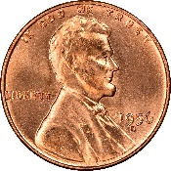
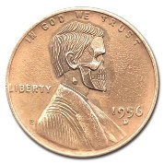
Reactions of Copper
Copy of Lab
brown stinkies
Cu(s) + HNO₃(aq) Cu(NO₃)₂(aq) + NO₂(g) + ?
Oxidation-
Reduction
A
B
Cu(NO₃)₂(aq) + NaOH(aq) Cu(OH)₂(s) + ?
Double
Replacement
Smurf brains
C
Cu(OH)₂(s) CuO(s) + ?
Decomposition
black chunkies
D
CuO(s) + H₂SO₄(aq) CuSO₄(aq) + ?
Double
Replacement
blue Kool-Aid “Star Trek – Transporter”
E
CuSO₄(aq) + Al(s) Cu(s) + ?
Single
Replacement
Mr. Lincoln has had a rough day, indeed.
Objectives:
Recover all of the copper you begin with (in analytically pure form)
Test your laboratory skills

Slide 3
The objective in this experiment is to recover all of the copper you begin with in analytically pure form. This is the test of your laboratory skills.
The percent yield of the copper can be expressed as the ratio of the recovered mass to initial mass, multiplied by 100:
% yield = x 100
recovered mass of Cu
initial mass of Cu
What is the maximum mass of copper that we can obtain?

Slide 4
Virtual Lab Instructions
Remote students will observe the lab and still complete the same documents.
Handwrite and paraphrase lab procedures for both days on notebook paper
Go through the lab and watch the video. This can be done by reaction or all at once. See the next two slides. Record observations on your lab report sheet.
Complete and balance the equations on the lab report sheet.
Using data provided for you later, determine the % yield of the lab.

Slide 5
Day One Procedure:
The entire lab with video of all five reactions can be found here. Otherwise, you can click individual links to take you to specific points within it. Fast forward as needed.
Weigh copper wire (approximately 0.500 g) to the nearest 0.001 g and place it in a 250 mL beaker.
Reaction A: Add 4-5 mL w/ disposable pipet (about 2 squirts) of concentrated HNO₃ to the beaker. After the reaction is complete, add 100 mL distilled H₂O.
Reaction B: Add 30 mL of 3.0 M NaOH to the solution in your beaker.
Reaction C: (~ 4 min of video; can fast forward) Carefully heat the solution while stirring with a glass stirring rod. DO NOT BOIL! Heat until it starts turning black.
Allow the black CuO to settle; then decant the supernatant liquid. Add about 50 mL of distilled water and allow the CuO to settle. Decant once more. Repeat 2 more times.
Copy of Procedure

Slide 6
Day Two Procedure
Reaction D: Add 15 mL of 6.0 M H₂SO₄ to black solid. Carefully swirl beaker to react solid on the sides of beaker.
Reaction E: Add small pieces of Al foil (or zinc) and a few drops (not squirts) of HCl. Heat the mixture vigorously, but without boiling, on a hotplate in fume hood. Allow to finish reacting overnight.
Decant solution and wash solid Cu with distilled water.
Weigh empty plastic dish and put initials on it.
Transfer Cu to weighing dish and allow it to dry overnight.
Weigh Cu product and determine % yield
% yield = x 100
recovered mass of Cu
initial mass of Cu

Slide 7
REPORT SHEET with Data
Chemical Reactions of Copper and Percent Yield
Copy of
Report Sheet
0.485 g
Day 1
1. Weight copper initial _______________
*2. Weight of recovered copper and evaporating dish _______________
3. Weight of evaporating dish _______________
*4. Weight of copper final _______________
*5. % Yield (show calculations) _______________
136.427 g
Day 3
135.973 g
Day 2
0.454 g
Day 3
Day 3
% yield = x 100
recovered weight of Cu
initial weight of Cu
*These values will not be obtained until the last day of the lab when the copper
has been dried in the evaporating dish.

Slide 8
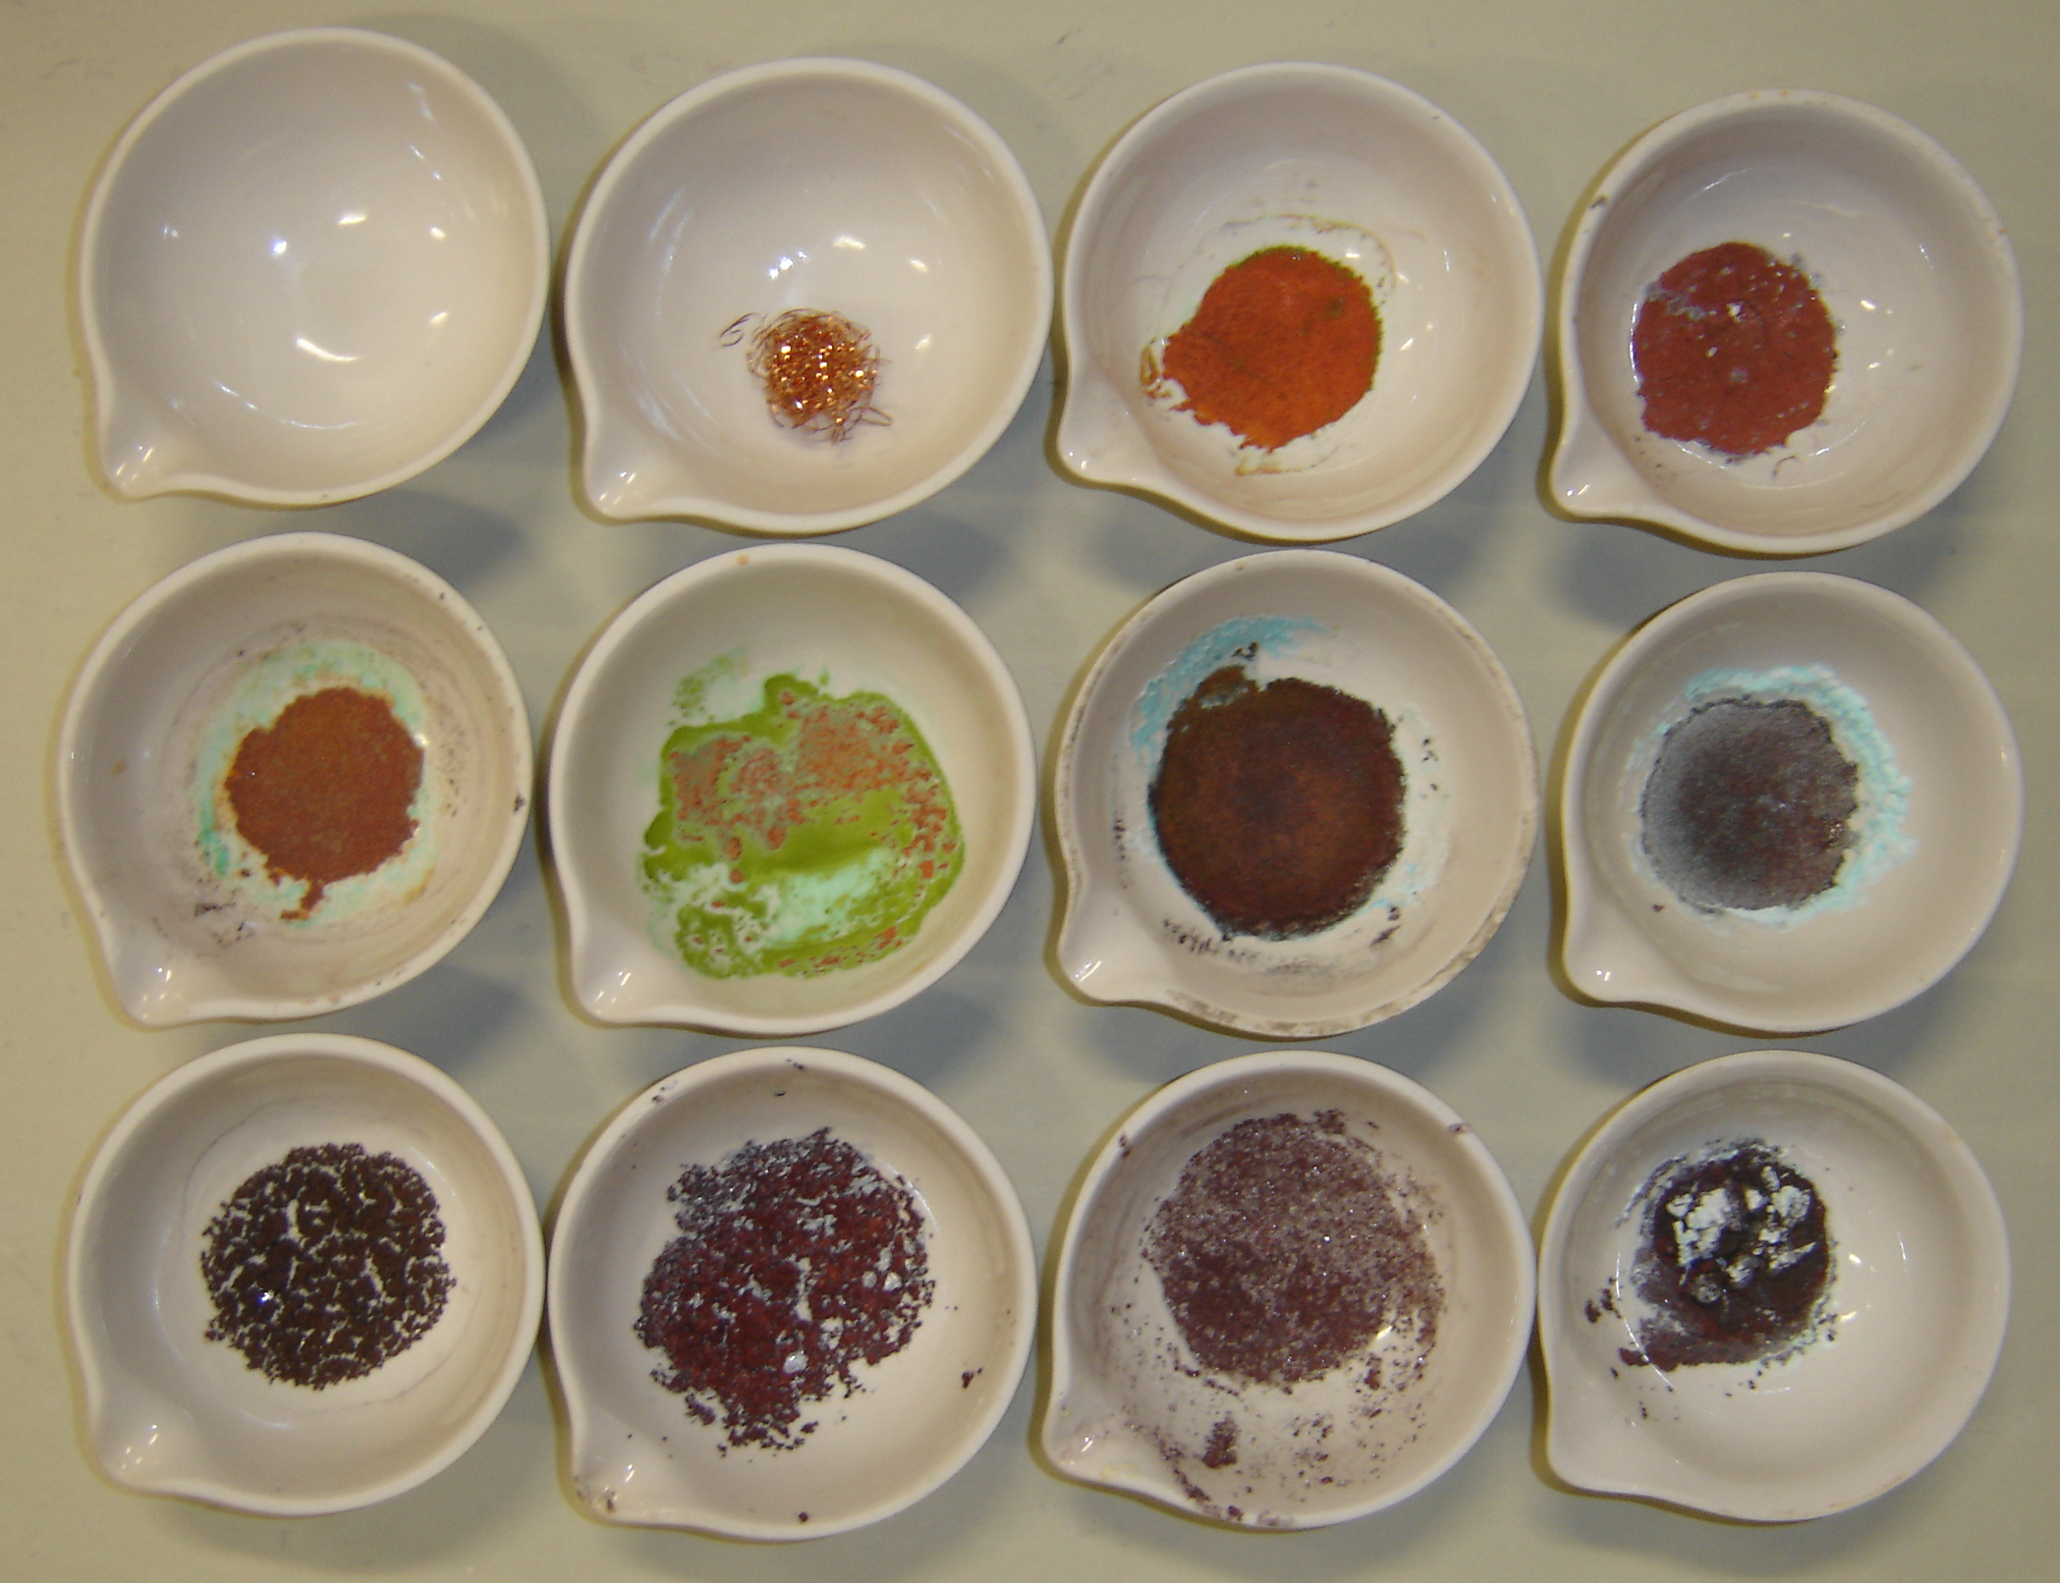
Cu sample at
beginning of lab
Few impurities…
should look like this!
Reactions
of Copper
CuCl₂
CuSO₄
Al foil
Al(SO₄)₃
AlCl₃
Photographs of copper samples at end of lab – note many have impurities.

Slide 9
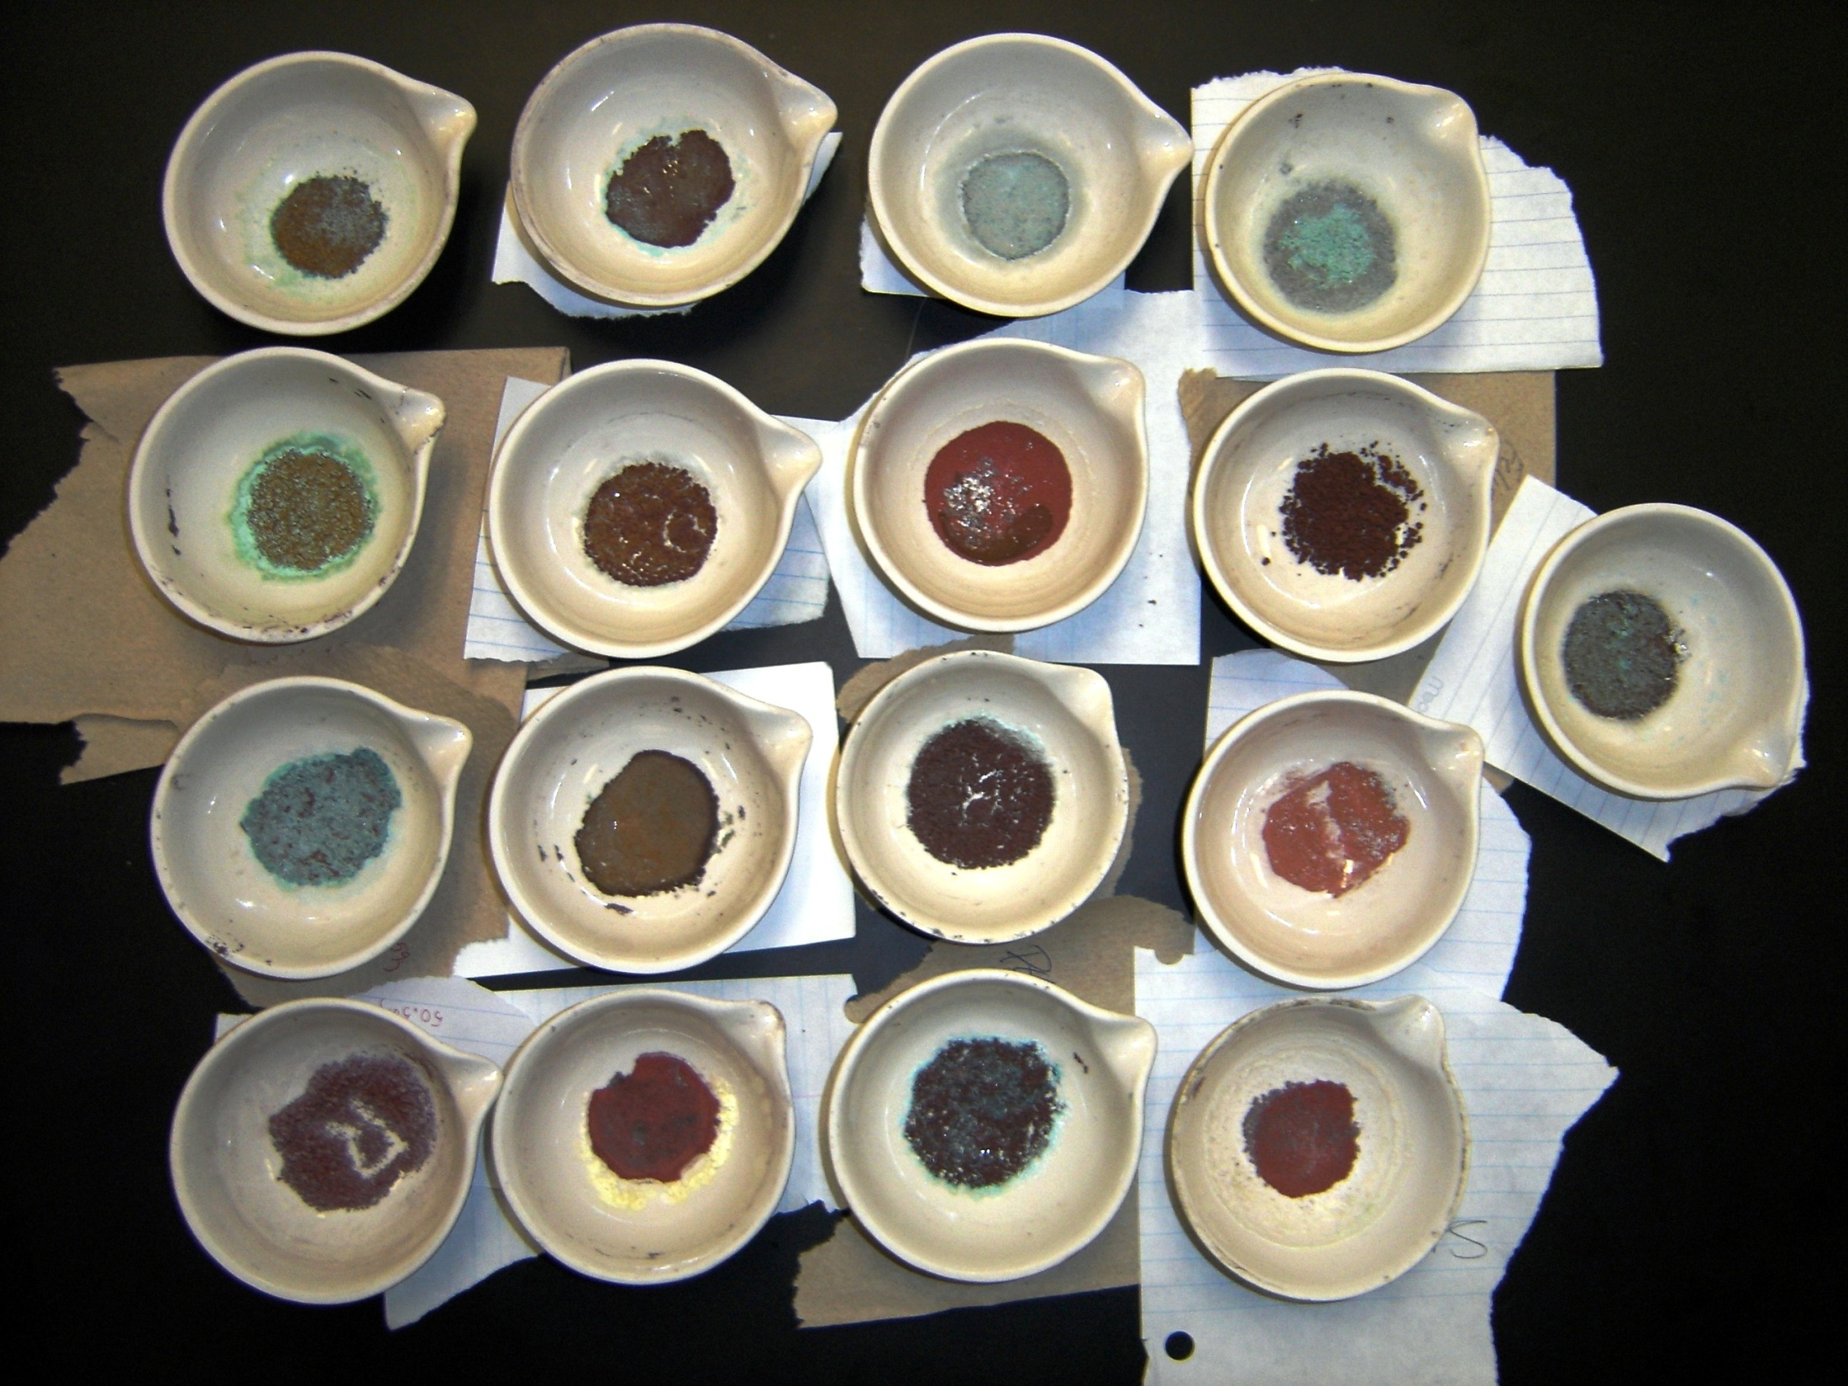

Slide 10

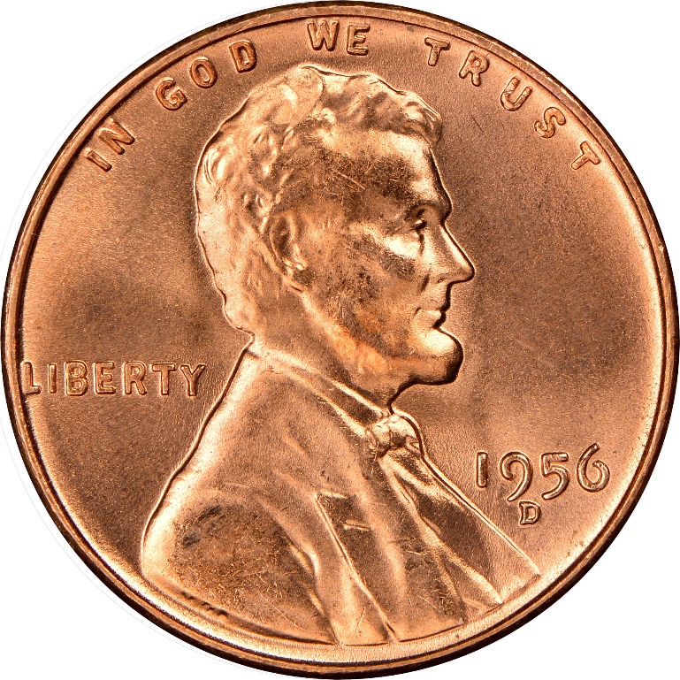
Mr. Lincoln has had a rough day, indeed.
Copper Metal S T A R T
Copper Metal E N D

